Slide 1
Wireless Sensing-based Daily Activity Tracking System Deployment in Low-Income Senior Housing Environments
MobiCom4AgeTech 2024
1st ACM Workshop on Wireless and
Mobile Computing for AgeTech 2024
MobiCom 2024
The 30th Annual International Conference on Mobile Computing and Networking Nov. 18-22, 2024, Washington, D.C., USA
Md Touhiduzzaman¹, Jane Chung², Ingrid Pretzer-Aboff³, Eyuphan Bulut¹
¹Department of Computer Science, Virginia Commonwealth University, Richmond, VA, USA
²School of Nursing, Emory University, Atlanta, Georgia, USA
³School of Nursing, Virginia Commonwealth University, MCV Campus, Richmond, VA, USA
Notes:
I am Md Touhiduzzaman, a Ph.D. Student at the Department of Computer Science of Virginia Commonwealth University (VCU).
I am about to present our research work, titled “Wireless Sensing…”.

Slide 2
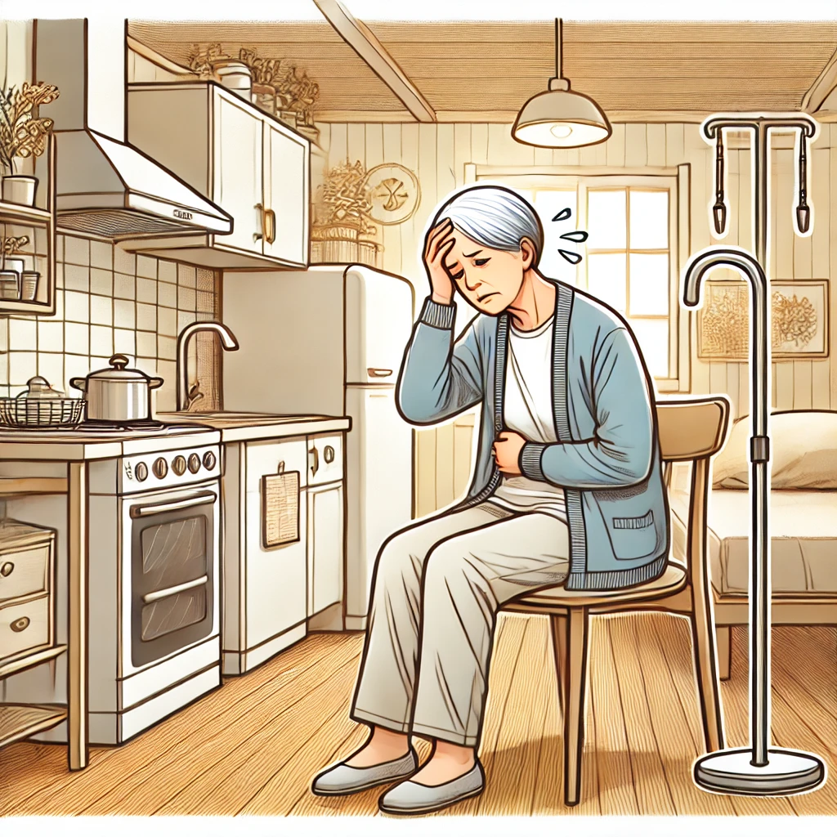
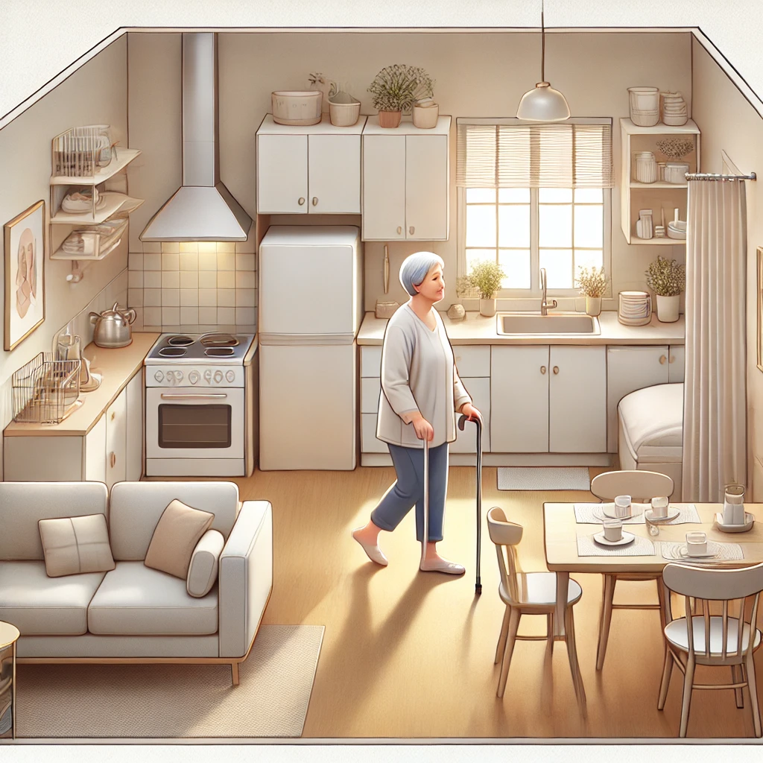
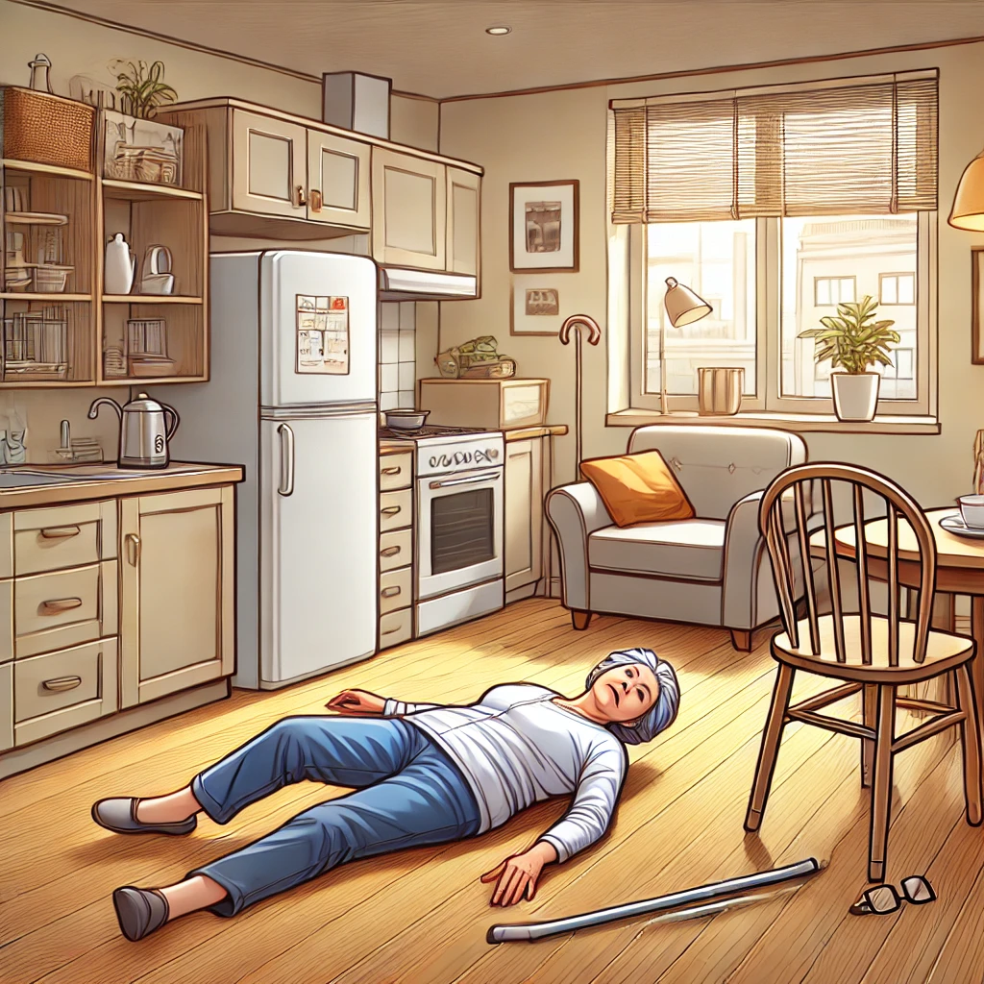
Subjects & Objective
Older Adults
Living Alone
Low Income
Privacy Preserving Monitoring
Irregularity in Activities
Emergency Situations
Notes:
The subject of our study is our older adults – living alone -- in elderly care or nursing homes.
As they age, they tend to lose their ability to care for themselves.
So they are at a high risk of adverse health outcomes and decreased quality of life.
[Change to the 2nd picture]
It is essential to routinely monitor their daily activities and mobility in a way that preserves their privacy.
Because, we want to capture any early decline before a clinical symptom arises.
[Change to the 3rd picture]
This kind of monitoring gets crucial in emergencies, like when they fall and there is no one helping around.
For such scenarios, existing solutions involve self-reporting or camera & wearable devices.
But -
Cameras are mostly privacy intrusive,
and wearable devices are a burden to carry as well as less convenient to recharge for our older adults.
From these observations, we have developed a solution involving WiFi sensing.
Now, what is WiFi sensing?
Subject - Older adults
As they age, Lose ability
High risk
Adverse health outcomes &
Decreased quality of life
Routinely monitor
Daily activities & mobility
That preserves their privacy
Because-
Capture any early decline
Gets crucial in emergencies
Exising
Cameras – privacy intrusive
Wearables –
Burden to carry
Less convenient to recharge for our older adults
Observations – solution – WiFi Sensing
Now, what is WiFi Sensing?

Slide 3
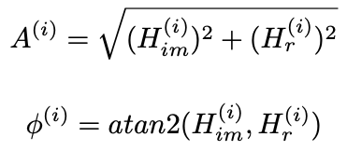
Solution: WiFi Sensing
Uses WiFi signals to perform physical sensing tasks
Works without light sources
Does not require Line-of-Sight (LOS)
Two types of data:
RSSI (Received Signal Strength Indicator)
Scalar RSSI Values for each received WiFi Frame
CSI (Channel State Information)
Complex Vector CSI value for each received WiFi Frame per antenna
Our CSI Toolkit: https://github.com/MoWiNG-Lab/ESP32-CSI-Tool
Orthogonal frequency-division multiplexing (OFDM) encodes data on multiple subcarrier frequencies
output CSI input noise
CSI describes amplitude and phase variations:
64 subcarriers where 52 contain CSI & 12 are null
CSI (H) is affected by:
Multipath Environment
Human Movement
Notes:
WiFi Sensing is a wifi signal analysis methodology, that can be used to sense different environmental and physical attributes and actions.
In contrast of camera and many other sensor based systems, it can work without any light source and does not require line-of-sight, i.e., it can be performed even with solid walls in between the sensors and the targets.
In the right-side animation, we can see how the received signal fluctuates depending upon a hand-movement within the plain WiFi transmission line in between a WiFi router and a user device.
We can analyze these sorts of properties using two types of data from WiFi capable devices:
Scalar RSSI (…)
A complex vector format, Channel State Info or CSI
In this study we have used CSI data using our own developed toolkit available as an open-source project in GitHub.
[Change-Animation]
We compute the amplitude and phase of the received CSI frames over the 64 subcarriers of our used ESP32 devices.

Slide 4
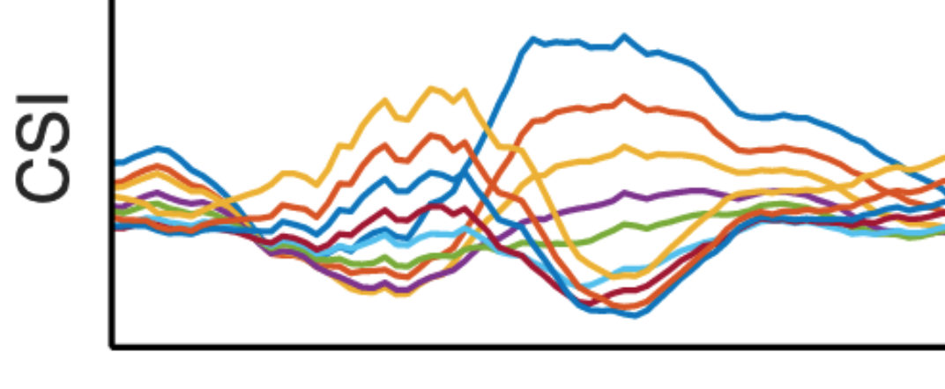
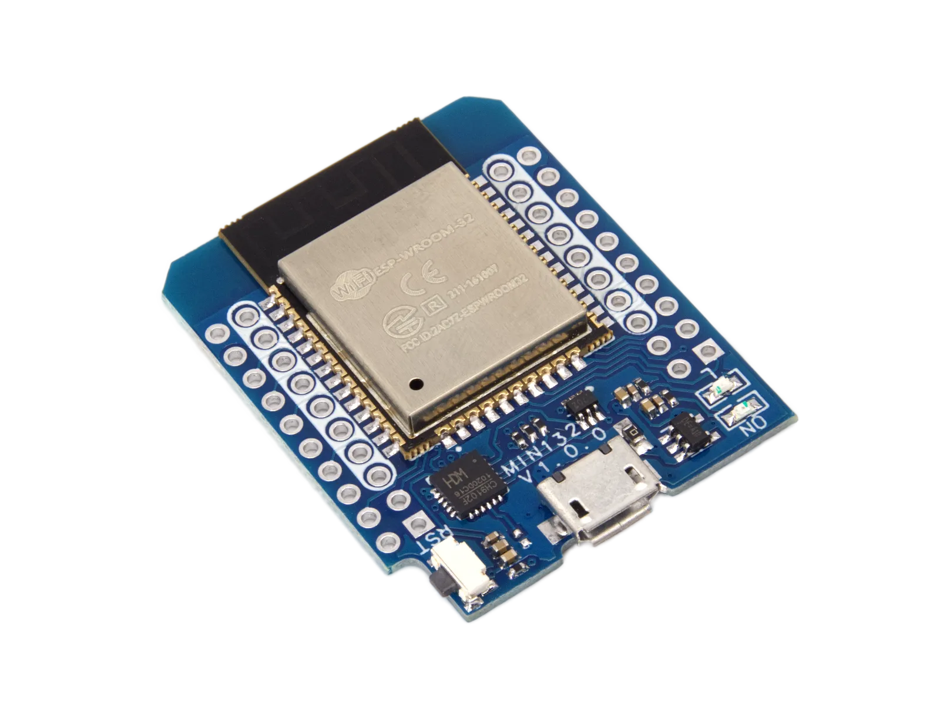
Solution: WiFi Sensing
Activity
No Activity
Signal Path
Subcarriers
ESP32
Signal Path
ESP32
Signal Path
Transmitter (TX)
Receiver (RX)
Notes:
These ESP32 devices are the core hardware needed for our proposed system.
We use one of these devices as the receiver or RX and pair another of the same device with it as the transmitter or TX.
Then any movement within their multipath transmission line is captured by the CSI data in the 64 subcarriers of these devices.

Slide 5
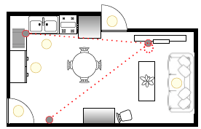
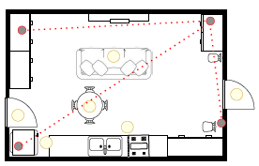
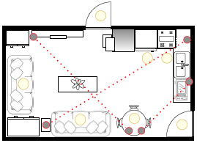
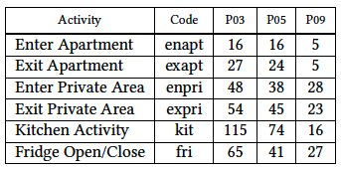
Data Collection
Age:
Range: 55~77 years
Average: 67.3 years
Nine Participants
One African-American Male
Six African-American Females
Two White Females
A week long
First time real deployment
Notes:
We have deployed multiple pairs of such devices in our 9 participants' apartments.
who’re from diff backgrounds & demographics and within the age range of 55 to 77 years
[Change-Animation]
The number and placement of ESP32 pairs depend on the layout and furniture allocations of the apartment, as can be seen in these layouts.
The red lines here represent the WiFi transmission line in between the Rx & Tx.
We deployed these devices in our participants' home for one week, on average.
and collected data for 12 hours a day, from 8am to 8pm, according to IRB regulations.
The novelty of our solution lies within this kind of deployment in real-life house environment performing thoughout a week.
[Change-Animation]
Although we monitored 16+ different activities within this period, we did not observe much repetitions of the activities, that’s why considered only 6 activities, like - … .

Slide 6
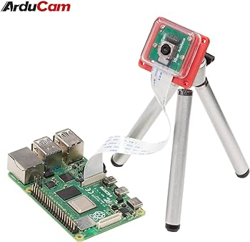
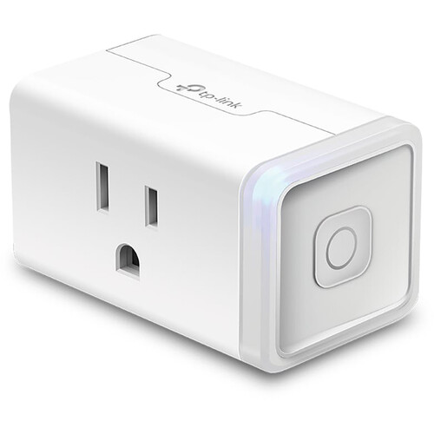
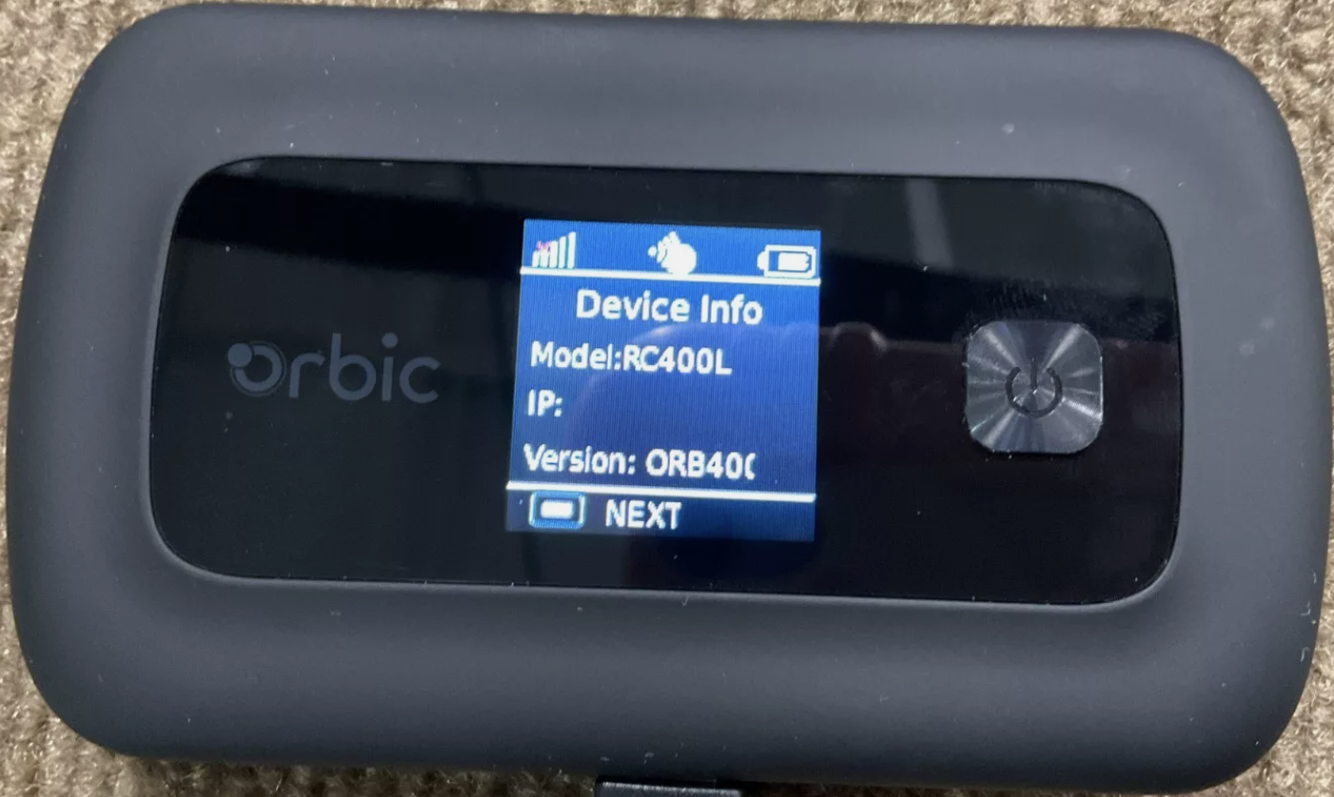
Deployment
System Components At The Participant’s Home
ArduCam
With Casing
& Tripod
TP-Link KasaSmart Plug
Array of ESP32s
E₁
E₂
.
.
.
.
.
.
E_{m}
Verizon Orbic Speed 5G WiFi Hotspot
Raspberry Pi 4B
Notes:
In our deployments, we used -
Raspberry Pi model 4B as the central computing and data collection unit.
An ArduCam with casing and tripod accompanied each Raspberry Pi to record the daily activites, so that we can prepare the ground truths or annotations for our training phase later.
As explained earlier, multiple pairs of ESP32 devices were connected to the Raspberry Pi. We only saved data from the Rx devices.
This setup was powered on through a TP-Link KasaSmart plug, which can be powered on/off remotely, in case we need to reboot that part of the system to fix any occurring issue.
All of these were then connected to the internet using a Verizon Orbic Speed 5G WiFi Hotspot.

Slide 7
Deployment
Remote Live Monitoring & Health Check
Software defined mesh VPN
End-to-end Encrypted Remote Connection using Wire-Guard
Enables Remote SSH Connections
R. Pi Set #1
R. Pi Set #2
Participant Home
KasaSmart
.
.
.
Monitoring End
KasaSmart
.
.
.
Remotely Switch Power On/Off
Reboots a faulty part of the system
R. Pi Set #n
Discord
Internet/Cloud
Discord
Reports data collection summary periodically to a webhook
Proactive resolution to a potential issue
Notes:
So, these are the at-home equipments for the participants, [ change-animation] all connected to the internet.
[Change-Animation]
To monitor over the data collection progress & proactively debug any issue, we used couple of other setups.
One of them is-
Tail-scale, which is a
Software defined mesh Virtual Private Network
It enables us to remotely SSH into any Raspberry Pi device to monitor & fix any issue.
This kind of connection is end-to-end encrypted using Wire-Guard, so that there may not happen any man-in-the-middle attack.
As mentioned earlier, we use KasaSmart app to remotely
control and
reboot a faulty part of the system
The data collection progress & system health are periodically reported to our Discord webhook setup.
This kind of reporting enables us to sense any inconsistency and fix it proactively.

Slide 8
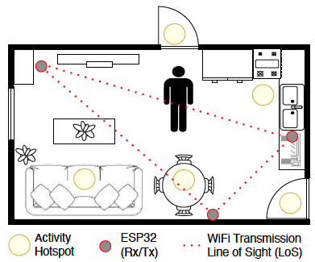
Deployment
Challenges
Unexpected Person
Pets
Device Positioning
Device Heating
Heaters & Fans
Maintenance Emergency
Notes:
We faced several challenges during this real-life setup.
Firstly, our system is focused on monitoring a single person living alone, but there maybe a second person occasionally visiting or delivering items to the resident of the apartment.
Besides of unexpected persons, pets also created disturbance in our wireless data collection process.
Although we tried to on-board participants without pets, it was not always easy to exclude them.
So, instead, we needed to exclude those kind of data segments in this study.
Positioning the sensors and camera was a challenge, too.
We needed to take our time to look around the apartment for
easier power access,
better line of sight, and
most area coverage using minimum number of sensors and cameras.
This varied for different deployments due to different apartment layout and furniture allocations.
In our early deployments, we observed our raspberry pi devices getting too hot for running too long.
To resolve this issue later, we added cooling fans in plastic cases.
In the participants’ home, there were fans creating unexpected and continuous movements.
It also made our machine learning more challenging.
Once, a heater was positioned very close to our sensor & it damaged the equipment.
In addition to that, one of our participants had water leak damaging our equipment.
After collecting the data throughout these challenges, we needed to roll over the recorded videos to annotate our interested actions.

Slide 9
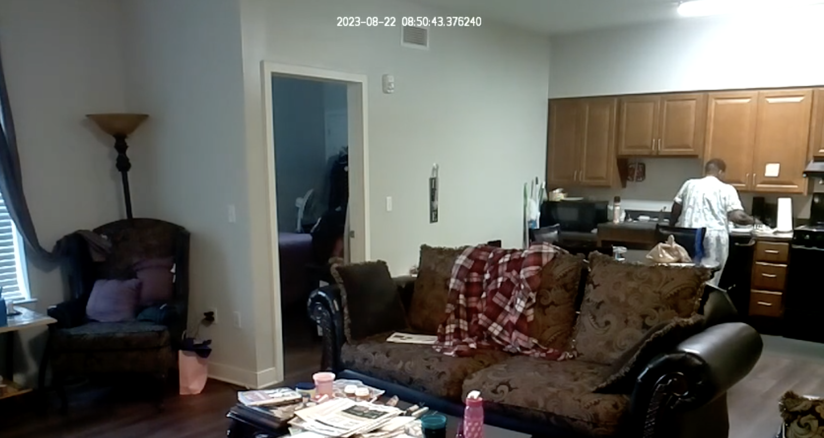
Post-processing (Annotations)
Kitchen Activity
But, wait ...
9 participants
7 days of video data (on average)
12 hours a day recording
= 756 hours of video recording to check!
Notes:
Whenever, we could see our participant doing some action,
like doing kitchen activity in this screenshot,
we annotated the start and end time of the activity
and ignored all other non-activity or random-activity’s data.
[Change-Animation]
But it’s a manual & time-consuming task
.. We had 9 parti.
7 days long deployments and 12 hours a day recording
Totaling into 756 hours of video recording to check manually.
That’s why we could include only 3 participants for this specific publication among all 9 deployed homes of the entire study.

Slide 10
ML Model Development
CNN model with CSI amplitude (𝑥) of a single WiFi-Link:
Input Layer
PCs x W
◦ ◦ ◦ ◦ … ◦
◦ ◦ ◦ ◦ … ◦
◦ ◦ ◦ ◦ … ◦
.
.
.
◦ ◦ ◦ ◦ … ◦
#PCs = 64
𝑥
Series of 2D CSI Windows
Flatten
Conv. Layer-0
Filters=8, Kernel=(3,3),
Max Pool Dim.=(1,1)
Conv. Layer-1
Filters=16, Kernel=(3,3),
Max Pool Dim.=(1,1)
Conv. Layer-2
Filters=16, Kernel=(3,3),
Max Pool Dim.=(1,1)
Dense Layer-0
#Nodes = 128
Model-1, ℎ₁(𝑥) / WiFi Link-1
Batch Normalization Layer
Batch Normalization
Dropout Layer, rate=0.2
Dropout Layer, rate=0.2
Activity Prediction
Output Dense Layer
CSI Window size, W = 100
PCA
Denoising
Dim. Reduction
Notes:
As for the ML model development, we passed the CSI amplitude of a single WiFi Link into a CNN model.
Firstly, we perform PCA on the CSI amplitude to denoise and reduce dimension.
Secondly, we prepare sliding windows of size 100 over all the 64 principal components and
Then pass the CSI windows to the CNN model with
2 hidden convolutional layers and 1 dense layer

Slide 11
ML Model Development
ℎ₂(𝑥)
ℎ_{𝑚}(𝑥)
…
ℎ₁(𝑥)
Final Activity Prediction
Notes:
Each of these CNN models works only with a single WiFi link among multiple links deployed based on the apartment layout.
We then define a-
Gradient-Boosting based Ensemble Prediction model
using the Logistic Loss function for each action i
The final predictions are made by –
combining all the CNN models’ predictions as base learners
into a Gradient-Boosting Ensemble Model
The benefit of this kind of prediction is –
each WiFi link tend to give better recognition for activities happening around that link,
but not so good for the non-LoS activities in this kind of real-life setup.
The ensemble model acts per action basis and makes the final prediction by giving priority to the base model yielding higher accuracy for specific actions.

Slide 12
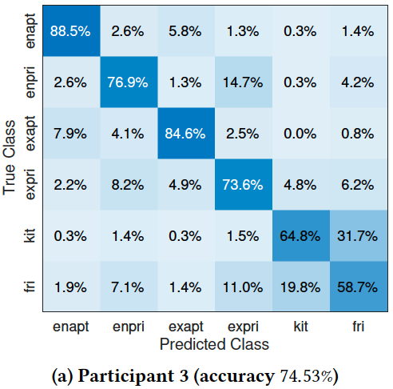
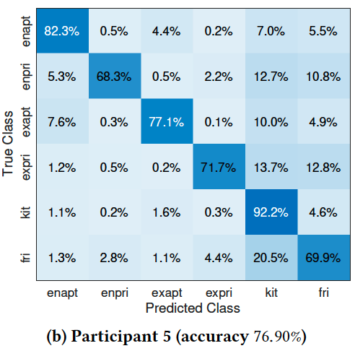
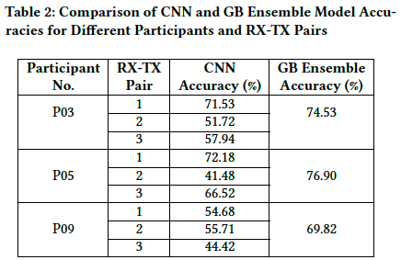
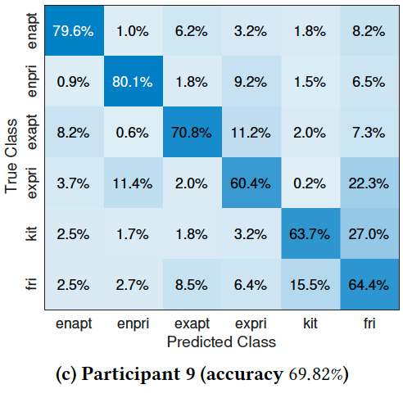
Evaluation
Figure 5: Confusion matrices of ensemble model for three participants
Notes:
We can see the base learners accuracy
varied in between 41 - 72%
for the 6 monitored activities
of the 3 participants.
But when we combine their accuracy using our developed Gradient-Boosting ensemble model, we achieved up to 77% accuracy.
In the confusion matrices, we can see kitchen and fridge activities look like the most confusing ones as they used to occur in the same place.
Please note that, these prediction are made every second
We can easily apply majority voting for a longer time range over these predictions and achieve very high, even almost 100% prediction accuracy.
Talking about this kind of improvements, we have more future works planned.

Slide 13
Future Works
Complete Annotations
Analyze temporal changes
Environment Independence
P03
P05
P09
Only 22.2% Annotations
Final Prediction
Final Prediction
Final Prediction
Notes:
We have annotated only 22.2% of our collected data and this is a work in-progress.
In time, we are to complete annotating all the data.
And given more data, we can improve the existing system’s accuracy, as well as look for better systems.
Besides,
[Change-Animation]
There’re studies showing that WiFi signals fluctuates by itself from time to time, especially for multiple-days-long deployments.
Our system was deployed a week long, too.
So, according to these studies, there are device dependent temporal changes in our data.
Besides, the WiFi spectrum response to any real-life environment change, like a furniture re-allocation.
Given these temporal changes analyzed properly, we can further improve our system.
[Change-Animation]
Thirdly, we are predicting activities for each of the participants separately in this study.
But we can negate the effect of the environment using some existing methodologies and develop a single model predicting these activities for all the participants’.

Slide 14
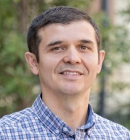
Thanks!
Presenter: Md Touhiduzzaman, Ph.D. Student
touhiduzzamm@vcu.edu
PI: Jane Chung
Associate Professor
School of Nursing
Emory University
Co-I: Ingrid Pretzer-Aboff
Professor
School of Nursing
VCU
Co-I: Eyuphan Bulut
Associate Professor
College of Engineering
VCU
Notes:
Thank you for taking the time to listen to our work.
Besides, thanks to PennAiTech for funding this study.
Also thanks to our PI and CoPIs for assisting.
If you have any questions, please feel free to email me or any of the authors.
I am also here now for any questions from our esteemed audiences.

