Slide 1
Wi-PT: Wireless Sensing based Low-cost Physical Rehabilitation Tracking
Steven M. Hernandez¹, Md Touhiduzzaman¹, Peter E. Pidcoe², Eyuphan Bulut¹
¹Department of Computer Science, Virginia Commonwealth University, Richmond, VA 23284, USA
²Department of Physical Therapy, Virginia Commonwealth University, MCV Campus, Richmond, VA 23220, USA
Emails: {hernandezsm, touhiduzzamm, pepidcoe, ebulut}@vcu.edu
Notes:
I am Md Touhiduzzaman, a Ph.D. Student at the Department of Computer Science of Virginia Commonwealth University (VCU).
I am about to present our research work, titled “Wi-PT: …”.
Besides of myself, this paper is authored by Steven M. Hernandez, Dr. Peter E. Pidcoe and Dr. Eyuphan Bulut.
All of us are from the Dept. of Computer Science, except Dr. Pidcoe, who is from the Dept. of Physical Therapy of the same university, VCU.

Slide 2
Overview
WiFi Sensing
Wi-PT
CSI Data Collection
Preprocessing & Machine Learning
Evaluation
Data sets
Results
Conclusion
Notes:
In this paper, we have used WiFi sensing as the wireless sensing technology.
I am about to discuss WiFi Sensing in brief first.
Then I shall go through the architecture of our proposed system, Wi-PT and the evaluated results of it.
Let’s start from the basic: What is WiFi sensing?

Slide 3
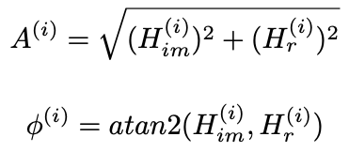
WiFi Sensing
Uses WiFi signals to perform physical sensing tasks
Device-free
Works without light sources
Does not require Line-of-Sight (LOS)
Two types of data:
RSSI (Received Signal Strength Indicator)
Scalar RSSI Values for each received WiFi Frame
CSI (Channel State Information)
Complex Vector CSI value for each received WiFi Frame per antenna
Our CSI Toolkit: https://stevenmhernandez.github.io/ESP32-CSI-Tool/
Orthogonal frequency-division multiplexing (OFDM) encodes data on multiple subcarrier frequencies
output CSI input noise
CSI describes amplitude and phase variations:
64 subcarriers where 52 contain CSI & 12 are null
CSI (H) is affected by:
Multipath Environment
Human Movement
Notes:
WiFi Sensing is a wifi signal analysis methodology, that can be used to sense different environmental and physical attributes and actions.
It is a device-free system, which, in contrast of camera and many other sensor based systems, can work without any light source and does not require line-of-sight, i.e., it can be performed even with solid walls in between the sensors and the targets.
In the right-side animation, we can see how the received signal fluctuates depending upon a hand-movement within the plain WiFi transmission line in between a WiFi router and a user device.
We can analyze these sorts of properties using two types of data from WiFi capable devices:
Scalar RSSI (…)
A complex vector format, Channel State Info or CSI
In this study we have used CSI data using our own developed toolkit available as an open-source project in GitHub.
[Change-Animation]
We compute the amplitude and phase of the received CSI frames over the 64 subcarriers of our used ESP32 device.

Slide 4
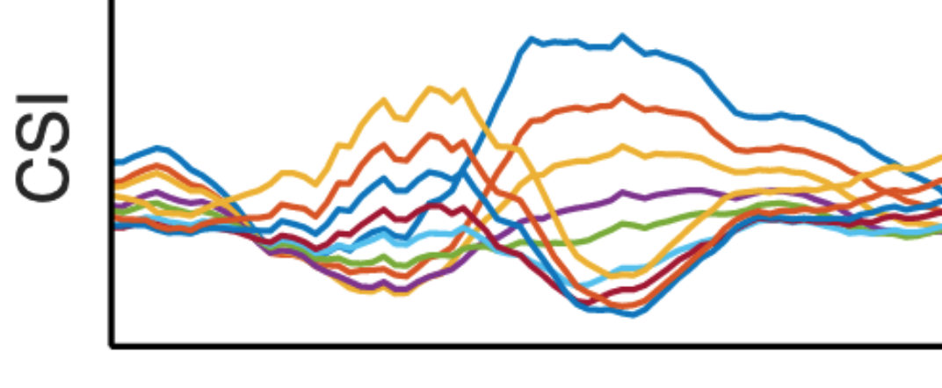
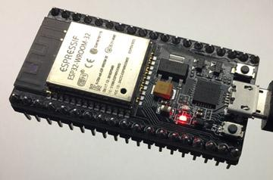
Wi-PT: Proposed System
A) CSI Data Collection
Activity
No Activity
Subcarriers
ESP32
Signal Path
Signal Path
ESP32
Signal Path
Transmitter (TX)
Receiver (RX)
Notes:
These ESP32 devices are the core hardware needed for our proposed system, Wi-PT.
We use one of these devices as the receiver or RX and pair another of the same device with it as the transmitter or TX.
Then any movement within their multipath transmission line is captured by the CSI data in the 64 subcarriers of these devices.

Slide 5
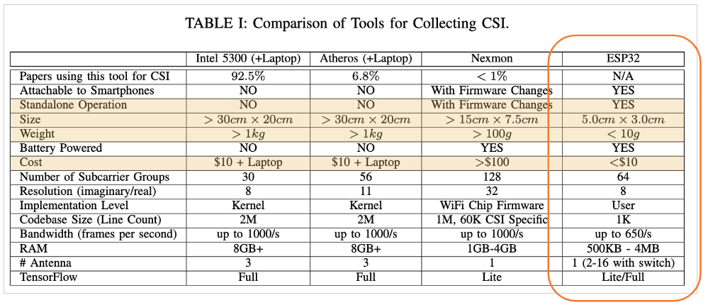
Wi-PT: Proposed System
A) CSI Data Collection
Notes:
But why have we used ESP32 instead of the other market ready devices?
As our work’s title claims – our solution is low-cost, and each ESP32 device cost below $10 in the current market.
Additionally, these are lighter & more computation capable than the other available devices in the market, like Intel 5300 NIC, Atheros or Nexmon.
These are why we use ESP32 devices for our study.

Slide 6
Wi-PT: Proposed System
B) Preprocessing & Machine Learning
Preprocessing:
Moving Average across each subcarrier independently using a window size w
Signifies each action duration
PCA for dimensionality reduction & to reduce noisy data
Notes:
So, after collecting the CSI data using ESP32 device, as well as our developed CSI toolkit, we need to process these data before providing these as inputs to our machine-learning model.
Firstly, we take the moving average of the amplitudes of each subcarrier using a specific window size, which signifies the duration of investigated action.
Then we run Principal Component Analysis or PCA for dimensionality reduction, as well as to reduce noisy data.

Slide 7
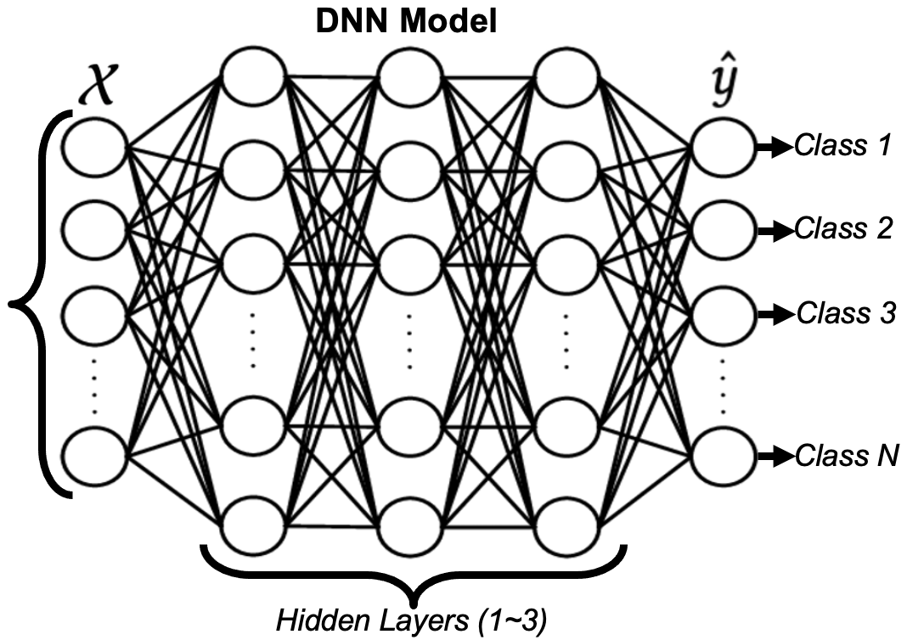
Wi-PT: Proposed System
B) Preprocessing & Machine Learning
Machine Learning
Given input (X) and output (y), find a model which minimizes the loss function, where, = Amplitude of the CSI Frame = True class for the CSI Frame
Class M
Hidden Layers (4 for equipment-based exercises & 2 for others)
Notes:
After these steps, our CSI data get ready to be fed into our DNN model, which targets to reduce the loss function with continuous predictions of the actions’ classes.
By extensive optimization of our model, we have found that 4 hidden layers work better for our equipment-based exercises, while 2 hidden layers are good enough for the other datasets.
It is noteworthy here that we have used a dropout layer after each hidden layer to overcome the overfitting problem in our model.

Slide 8
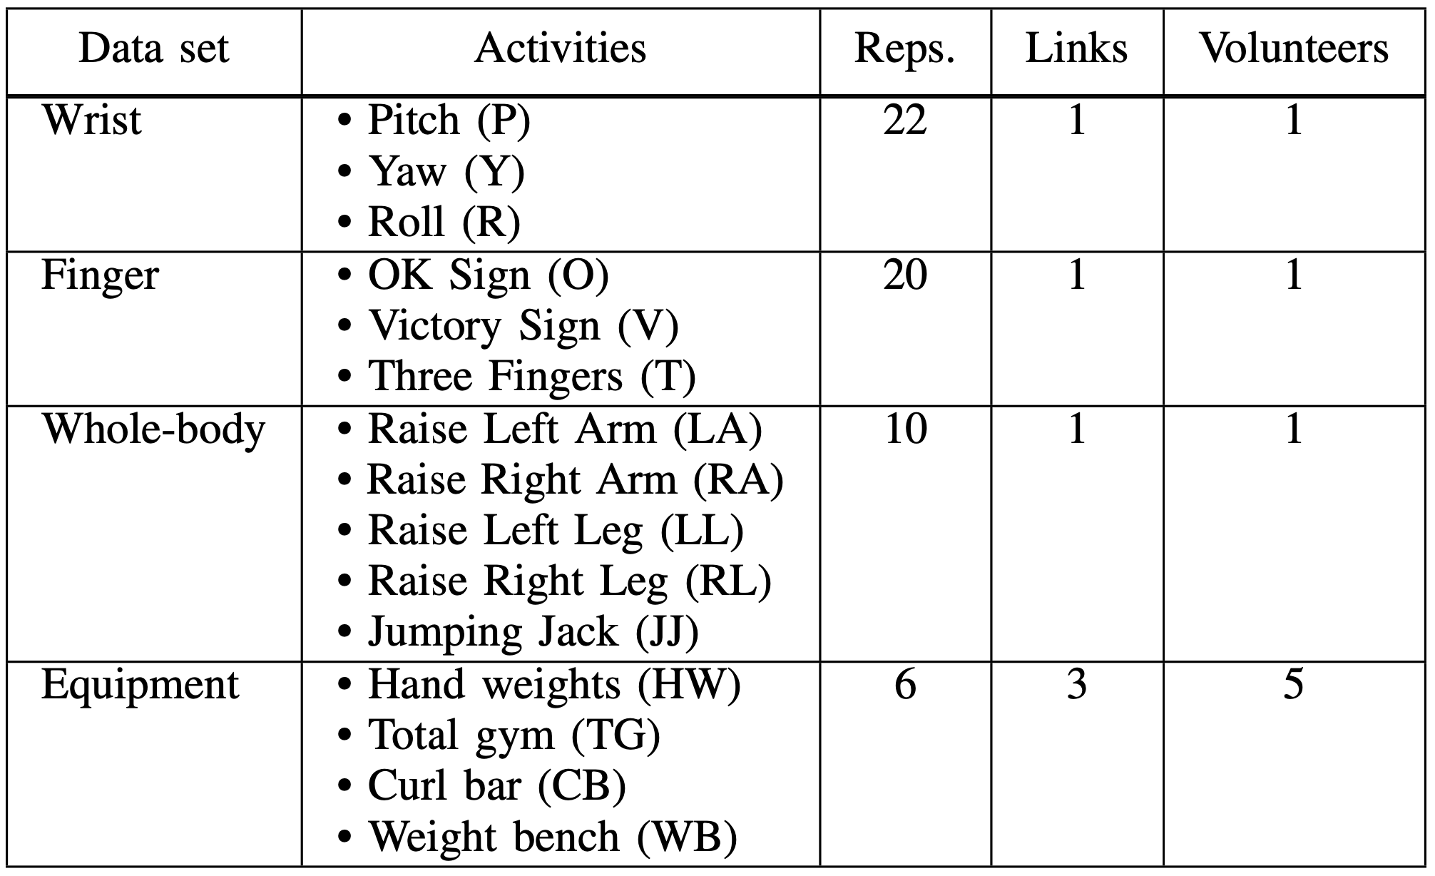
Evaluation
4 Physical Therapy Scenarios:
Notes:
To evaluate our proposed system, we have experimented with 4 sets of physical-therapy scenarios:
For physical therapy on wrists and fingers, we have classified 3 actions by one volunteer in each group with one single pair of transmitter-receiver.
Movements of two hands and two legs were jointly studied with jumping-jack action for a whole-body movement classification.
Lastly, we have studied 4 equipment based exercises using 3 pairs of Tx-Rx and 5 volunteers.

Slide 9
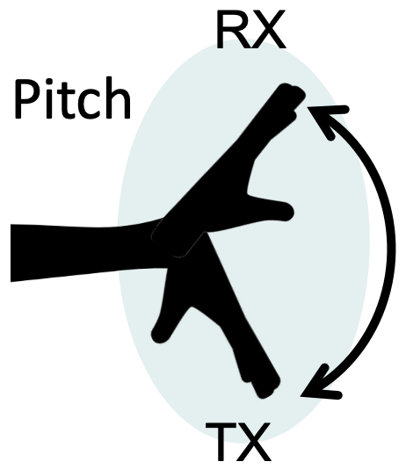
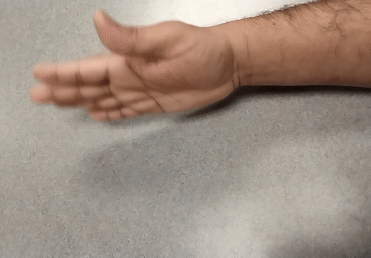
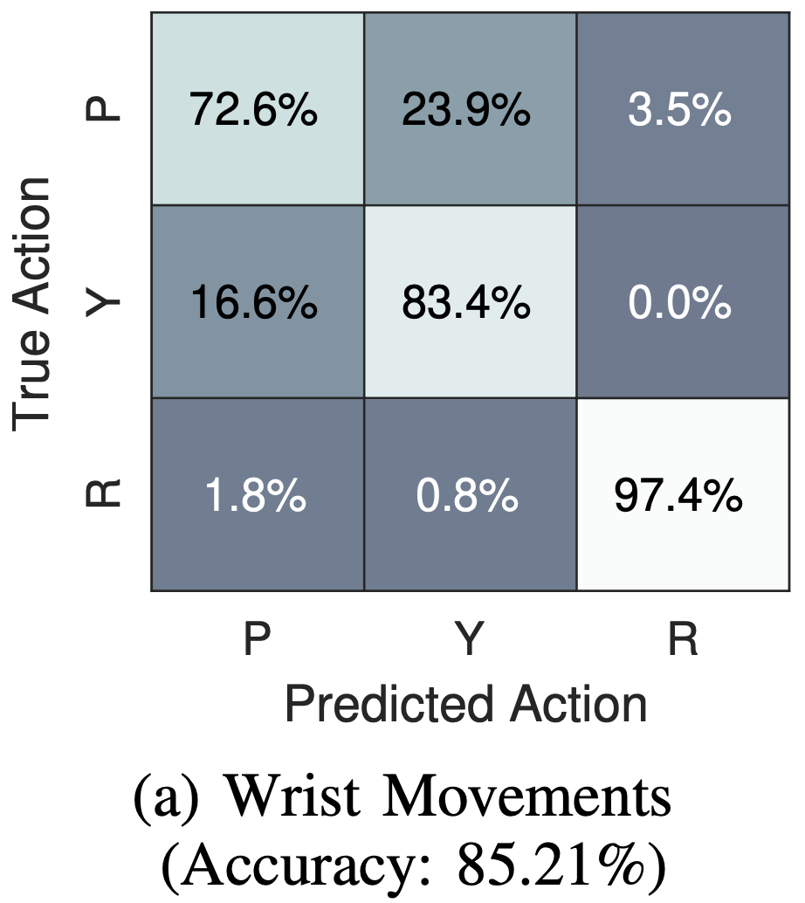
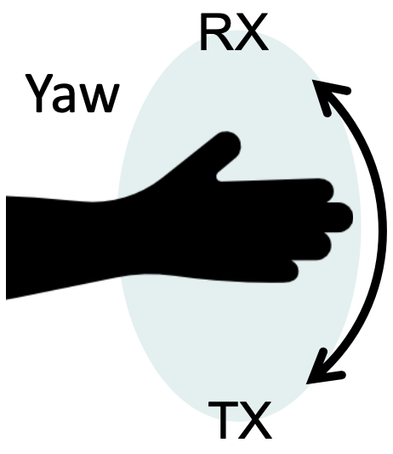
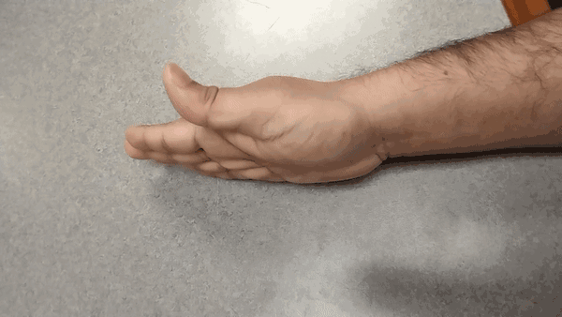
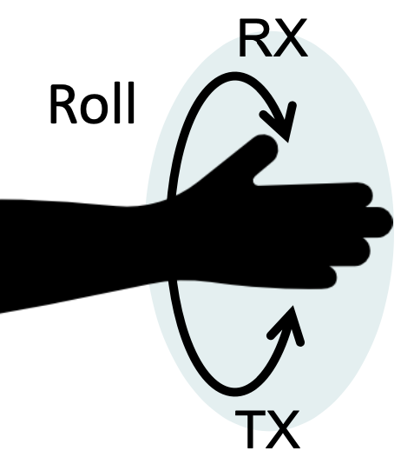
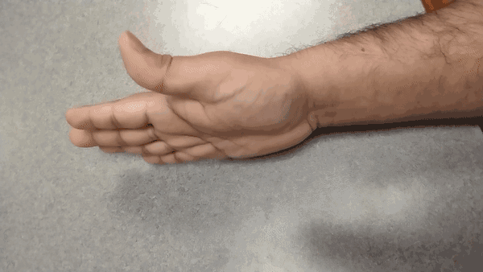
Evaluation
a. Wrist dataset:
(P)
(Y)
50 cm
(vertically)
(R)
Notes:
We can see the studied wrist-movements in the right-side GIFs here.
As I said, we used one pair of Tx-Rx for this study.
However, the pair is placed vertically (i.e., at the top and bottom of the hand) at a distance of 50 cm apart.
So, the signals get a thinner view of the palm from this angle and, to our understanding, it causes Pitch & Yaw movements to be less recognizable, For example - 72.6% is the accuracy for the pitch action identification.
But the rolling actions provide the signals a broader view of the palm to make recognizing this motion more accurately.
Overall, we have achieved 85.21% accuracy in classifying these 3 actions.

Slide 10
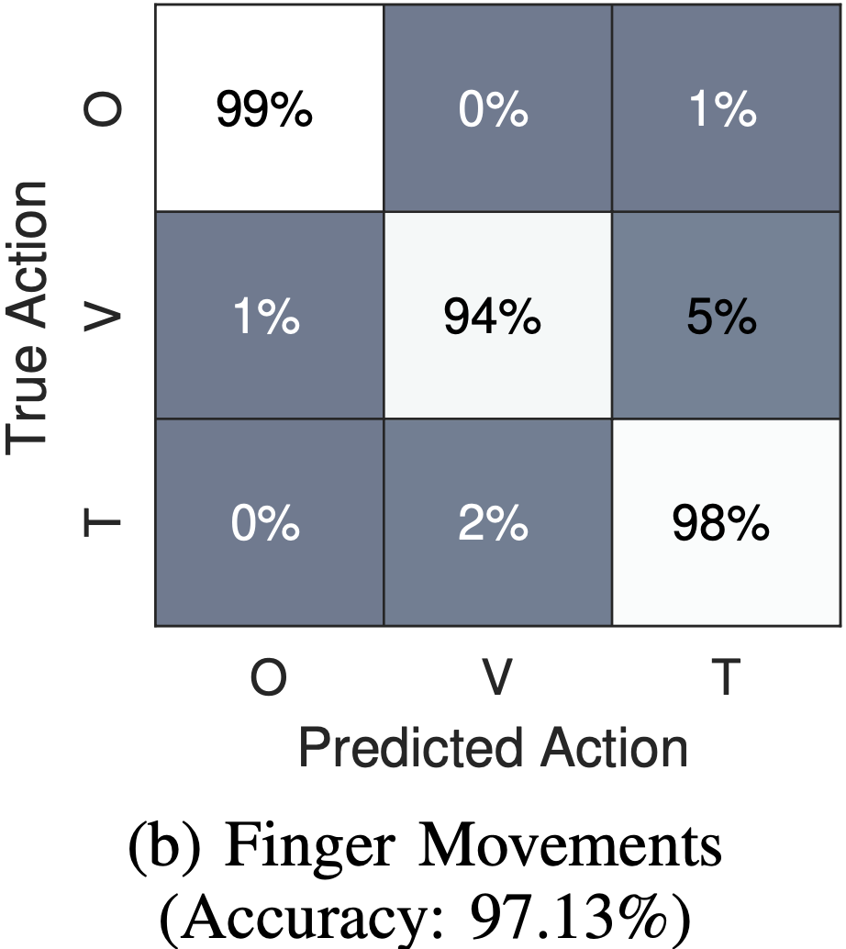
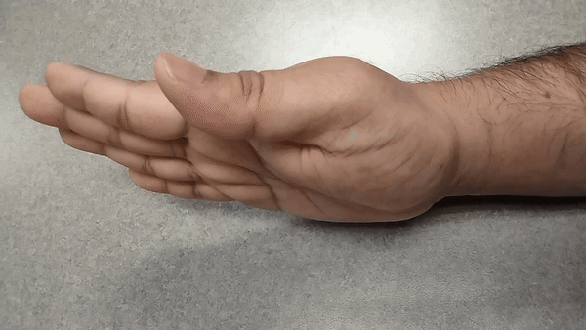
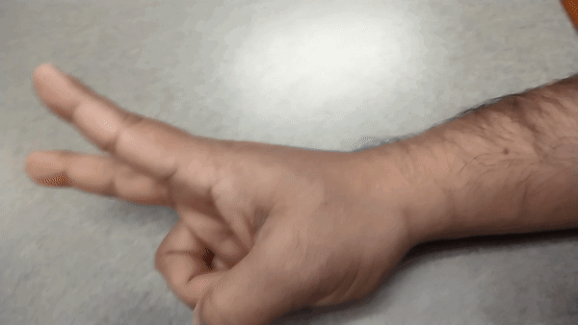
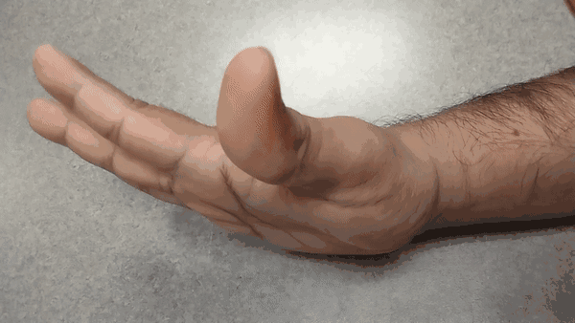
Evaluation
b. Finger dataset:
60 cm (horizontally)
(O)
(T)
(V)
Notes:
Classification of the 3 finger-movements, as shown in the GIFs on the bottom-right side, is found to be even more successful.
The accuracy in this case is 97.13%.
Here, we stationed the Tx-Rx pair horizontally along the palm at a distance of 60 cm.

Slide 11
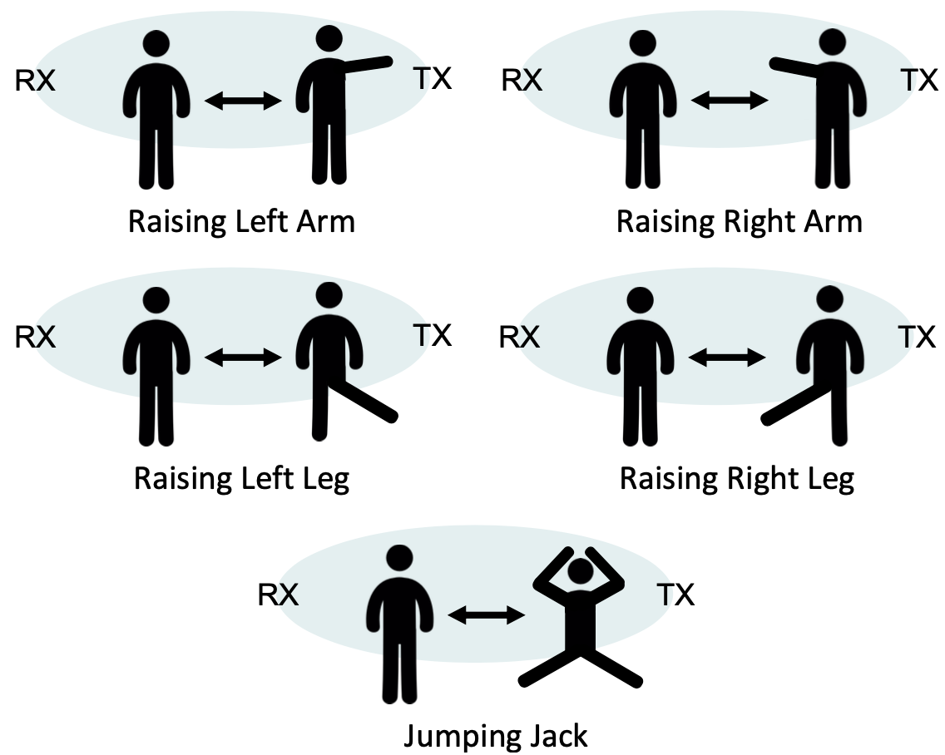
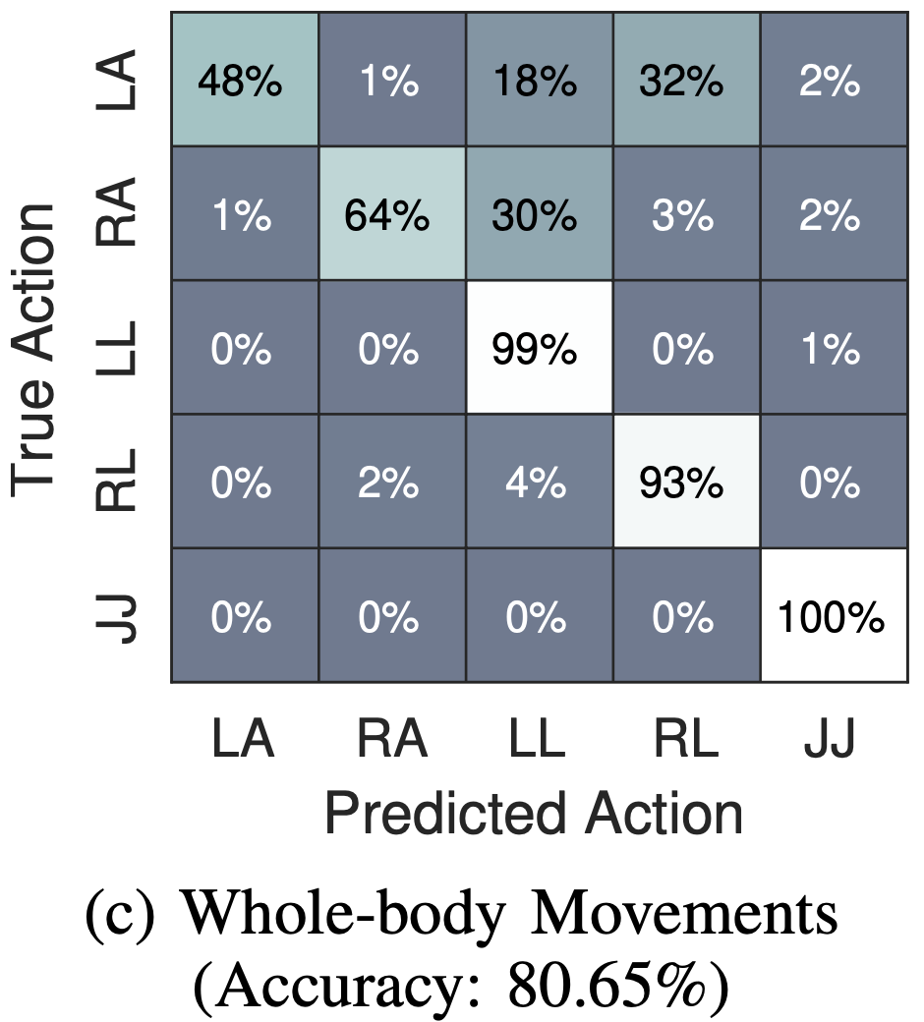
Evaluation
c. Whole-body dataset
(LA)
(RA)
(LL)
(RL)
(JJ)
2.40 m apart (horizontally at the eye-level)
Notes:
For a whole-body movement experiment, we considered 5 actions, like – raising up-down the left arm, right arm, left leg and right leg, along with the jumping jack action.
We used one Tx-Rx pair horizontally along the eye level.
The pair had a 2.4m distance in between and from front-to-back of the volunteer in this study.
For leg and jumping-jack movements, the accuracies were pretty convincing.
But the arm-movements were found to be confusing with the counter-side’s leg movement.
This can be explained from three angles:
One – the arms are tinier than legs
Two - while raised, the arms tend to go at the edge of the dense WiFi zone targeted at the eye-level.
Thirdly & most likely - raising any leg sidewise (left or right) makes the body tilt towards the opposite side. Therefore, the arm movement on that opposite side is likely to be confused with a leg movement on that side, especially if the TX/RX pair is close enough to the body.
However, we could achieve 80.65% accuracy at best with this dataset.

Slide 12
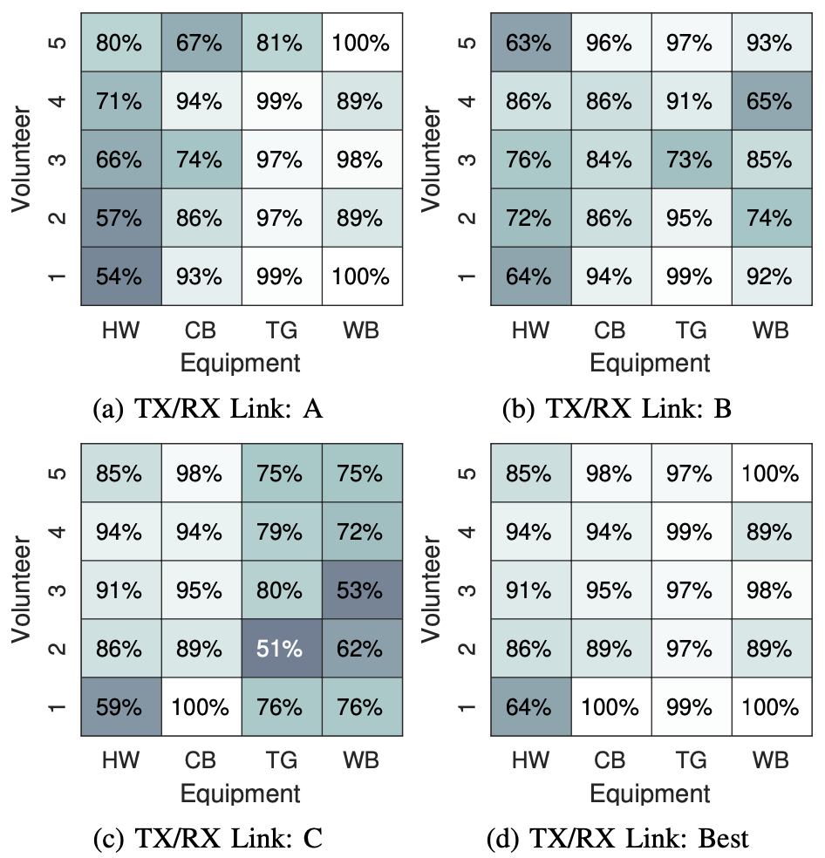
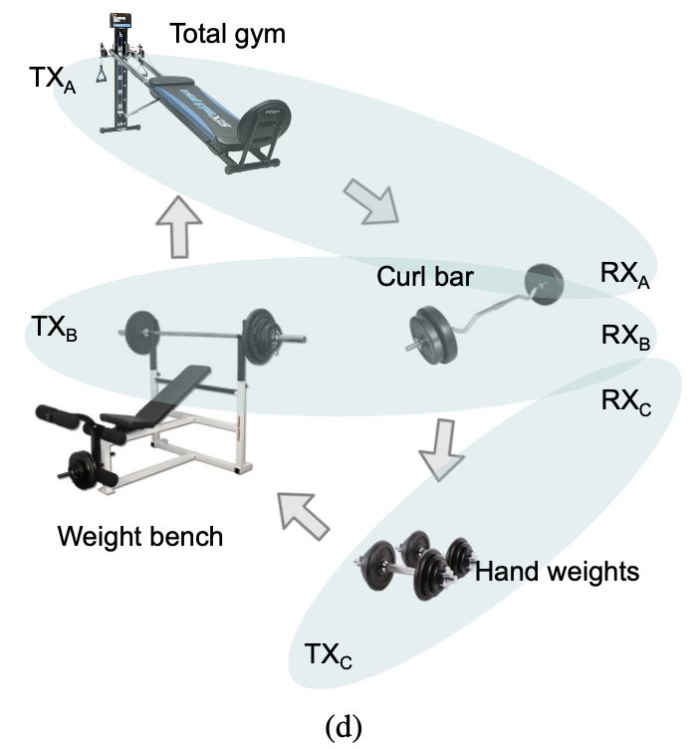
Evaluation
d. Equipment-based dataset:
(TG)
(CB)
(WB)
(HW)
Notes:
Finally, we had 5 volunteers performing exercises using 4 equipment: total-gym, curl-bar, weight-bench, and hand-weights.
There were 3 pairs of Tx-Rx around these 4 equipments in a room.
In the heatmaps, we can see that Link-A achieves the most remarkable accuracy across volunteers for the total-gym and weight-bench equipments, while link C achieves the highest accuracy across volunteers for hand-weights and curl-bar equipment.
Here, the middle-link, link B, achieves slight improvements for some of the volunteer/equipment pairs, but there is no consistent behavior where it achieves greater accuracy than the other TX/RX links.
As such, while link B does not itself achieve the greatest accuracy, it can still help to improve the overall system.
Moreover, hand-weight based exercises are seen as the most confusing one for all volunteers.
It can be due to the small movements of the hand weights compared to the activities performed at the other equipment locations.

Slide 13
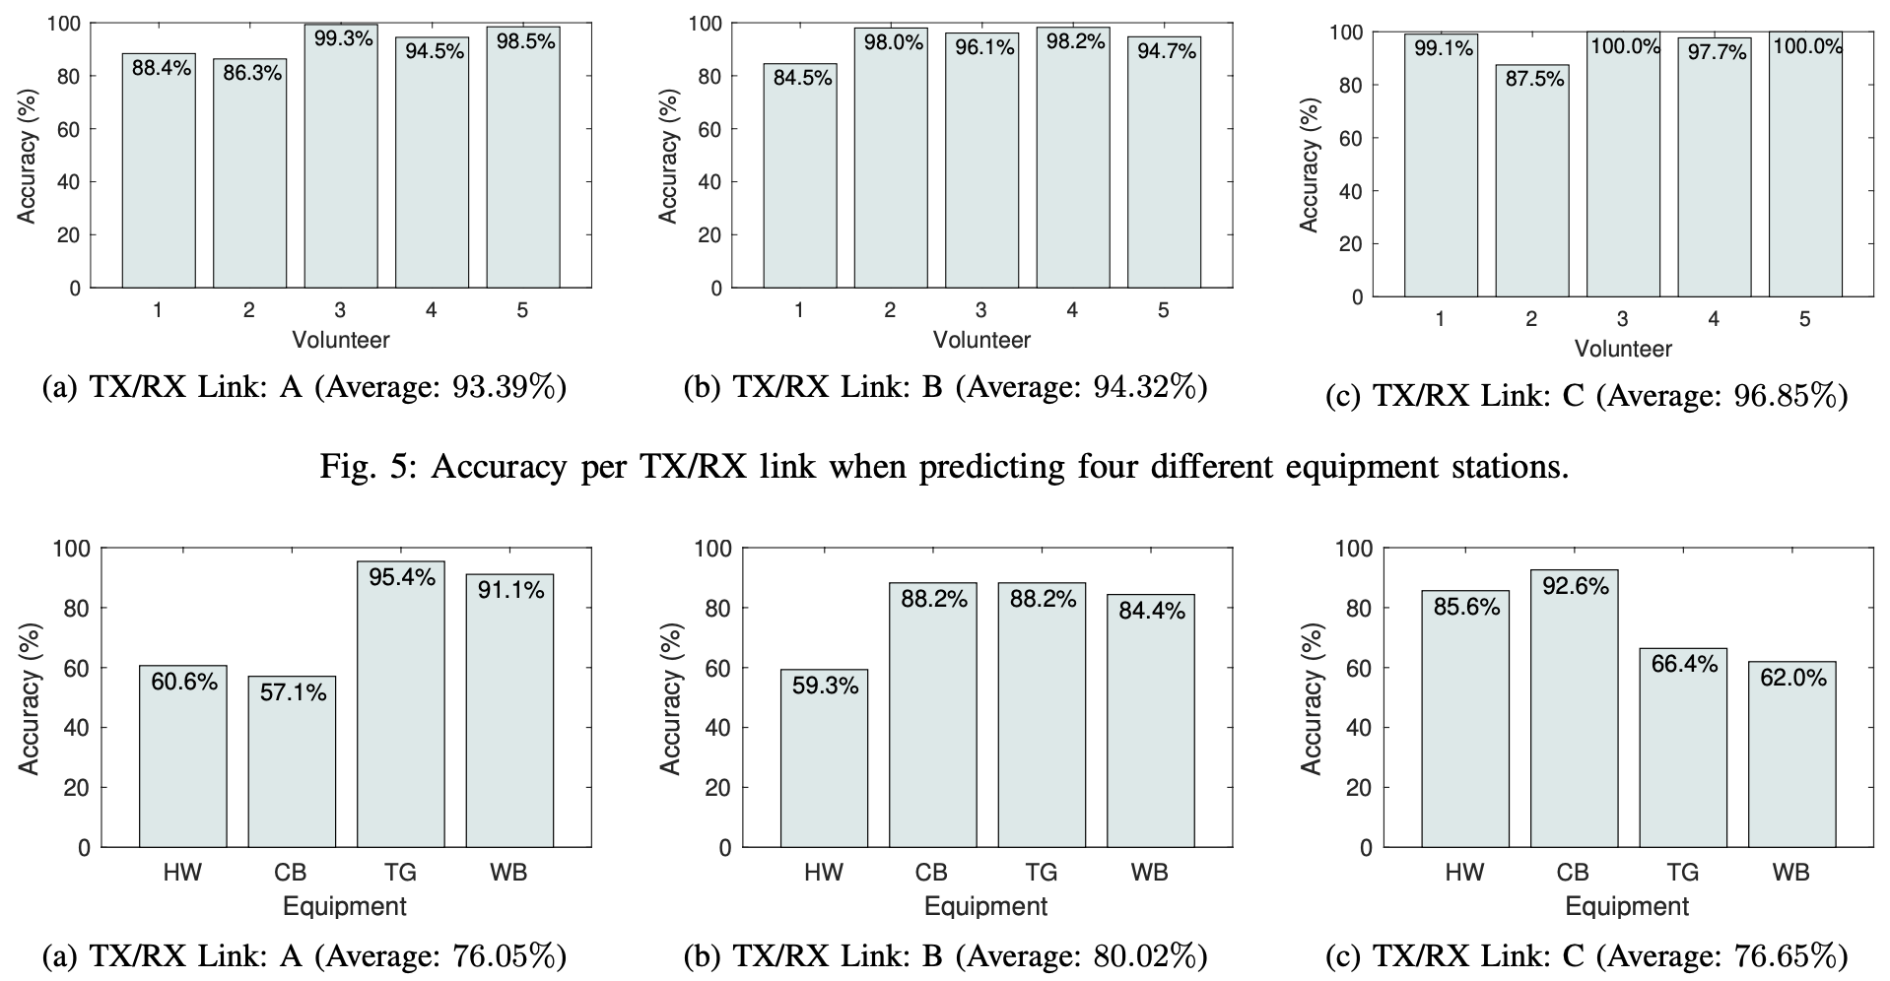
Evaluation
d. Equipment-based dataset:
Figure: Volunteer-wise Exercise Prediction
Figure: Equipment-wise Volunteer Prediction
Notes:
Next, we consider how well our system can predict which volunteer is doing which exercise as two separate problems:
The top 3 bar-charts show the accuracy of a multi-class classifier predicting the four different equipment stations using CSI captured with each TX/RX link, where the least average accuracy is 93.39% using the Link-A.
This demonstrates that even though only specific equipment is placed in the LOS of each TX/RX link, the models can still successfully distinguish which equipment is being used from any given link. Thus, we can see that link positioning is unimportant for equipment identification.
Alternatively, the bottom 3 bar-charts show that no single TX/RX link achieves high prediction accuracy for person identification at all equipment locations. This is because person identification relies on understanding details such as height, weight, and the way in which a volunteer performs each activity. As such, we find that the highest achieved accuracy for each TX/RX link corresponds directly to the equipment most closely located in the LOS of the TX and RX. This is because equipment located in the NLOS may have environmental noise such as fans as well as the physical movements being performed which may overshadow the human-identifying traits that could more easily be seen in the LOS.
Overall, the greatest accuracy that we can achieve for hand-weight is 85.6% while all other equipment achieves greater than 91.1% respectively.

Slide 14
Conclusion
Achievements:
Low-cost device-free system
High Accuracy
Multi-volunteer & Multi-TX/RX links for equipment-based actions
Future Scopes:
Data with more volunteers
Environment independent models
Evaluate WiPT for tracking physical therapy patients over longer periods of time
Notes:
To summarize, we can enlist our achievements in this study as –
To orchestrate a low-cost, device-free & highly accurate physical sensing system, which is also capable of working with multiple volunteers and multiple Tx-Rx links
As for our future scopes, we are planning –
to collect data with more volunteers,
Develop an environment independent model, and
Evaluate our system, WiPT, for tracking physical therapy patients over longer periods of time.

Slide 15
Thanks!
Presenter:
Md Touhiduzzaman
Ph.D. Student
touhiduzzamm@vcu.edu
Our Edge-Based WiFi Sensing Tool(s): https://stevenmhernandez.github.io/ESP32-CSI-Tool/
Notes:
Thank you for taking the time to listen to our work.
If you have any questions, please feel free to email me or any of the authors.
Thank you, everyone.

